Slide 1

Repute Engineers
Repute is the one stop solution provider for the food processing industries especially focusing on dairy and beverage sector. Dairy Industry demands highest standards for the equipment and solutions used in milk and milk products manufacturing so that the complete nutritional balance is maintained. Ever evolving and innovative processing industry for beverages places high demand on the solution provider to meet the new preferences of consumers.

Slide 2
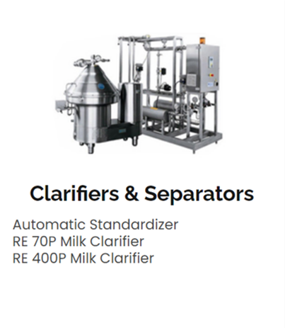
Dairy Segment
Dairy processing is growing rapidly across the world to cater to the increasing demand for milk and milk products from a growing population. REPUTE’s years of experience and comprehensive know-how is leading the way in processing one of the world’s most important and versatile foods.

Slide 3
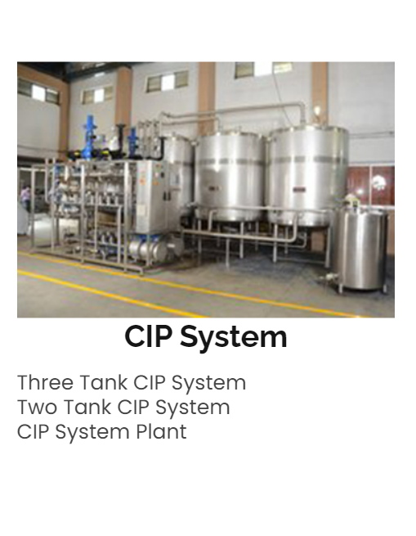

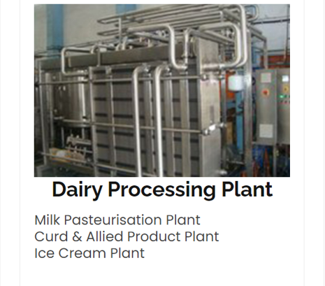


Slide 4

Beverage Segment
Non alcoholic Beverage consumption in India is more than 10% of the world’s total consumption rate, which make India the third largest country after United States and Republic of China. Given its size and population, the demand will definitely increase in the coming days. This shows the Indian Beverage Industry has a greatest potential for more processing plants and as such the demand for process plants & machinery.

Slide 5

